Slide 1
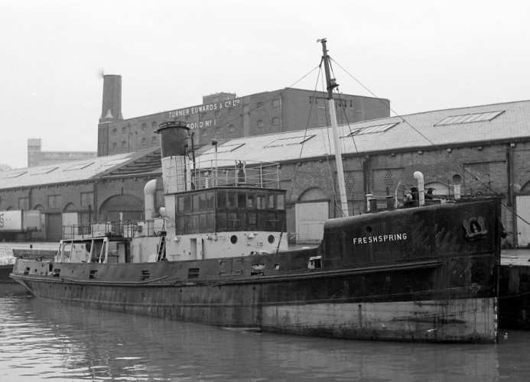
LO: To understand the history of steam ships
Success Criteria
I can tell you key facts about the history of SS Freshspring.
I can identify key figures in steam ship history.
I can identify key events in the history of steam ships.
I can record my findings on a timeline.

Slide 2
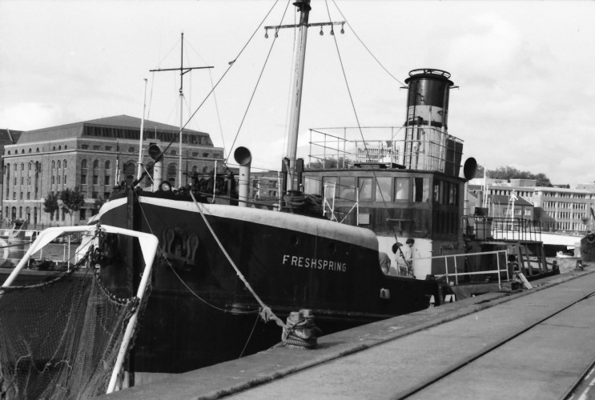
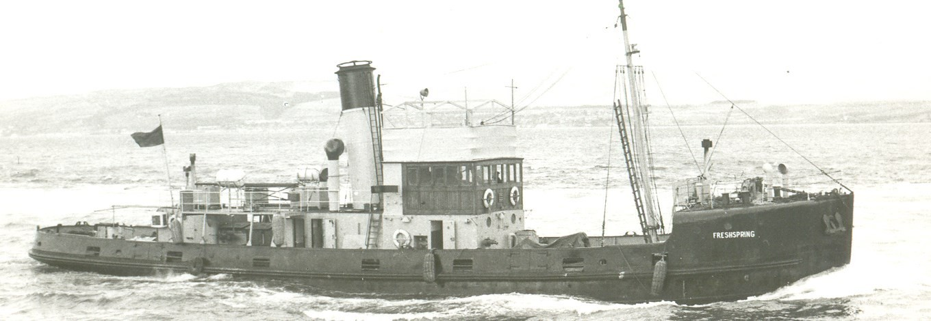
SS Freshspring
LO: To understand the history of steam ships
How old do you think SS Freshspring is?
How do you know?

Slide 3
LO: To understand the history of steam ships
Click to find out more about SSFreshspring.

Slide 4
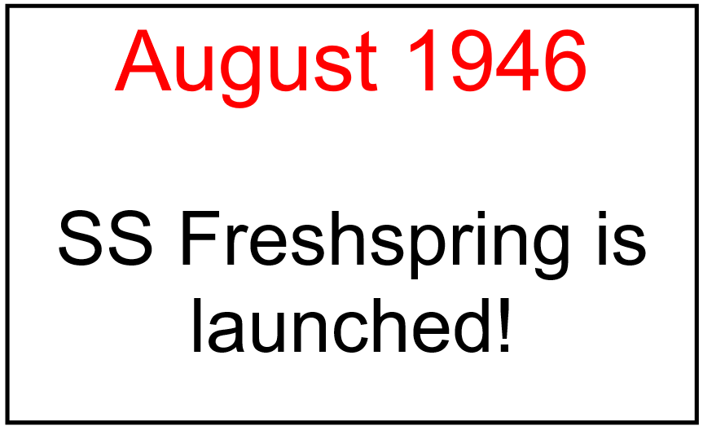
LO: To understand the history of steam ships
Let’s create a human timeline showing the history of SS Freshspring!
How far apart should each event be spaced?

Slide 5
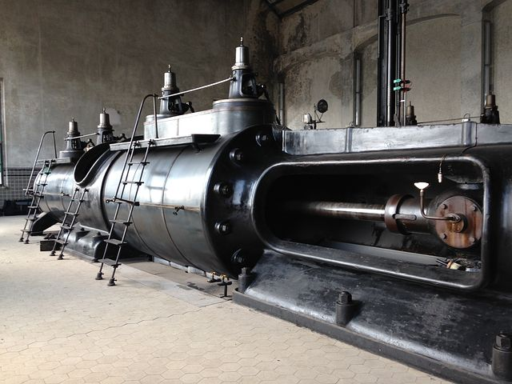
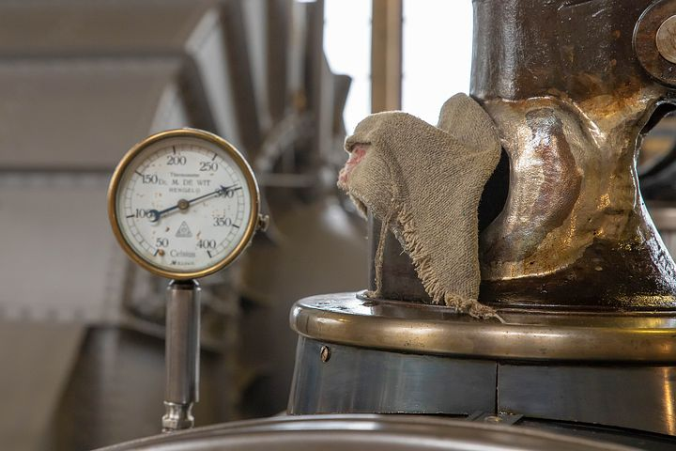
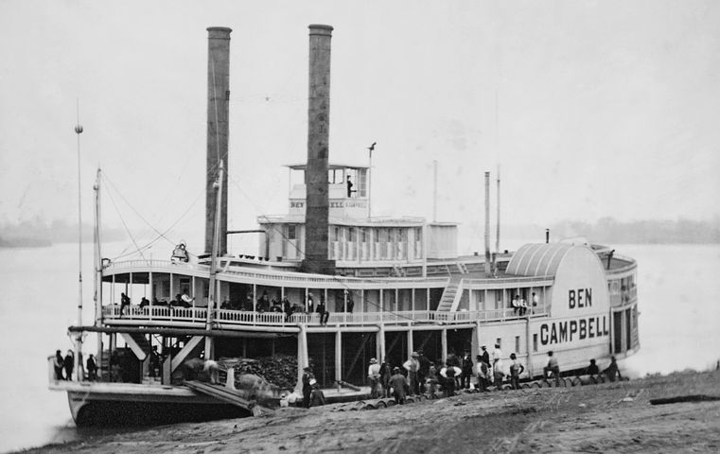
LO: To understand the history of steam ships
SS Freshspring is a steam ship.
What are steam ships?

Slide 6
LO: To understand the history of steam ships
Today, you are going to be creating your own timeline showing the history of steam ships!
How will we find out our information?
Don’t forget to stay safe using the internet!

Slide 7
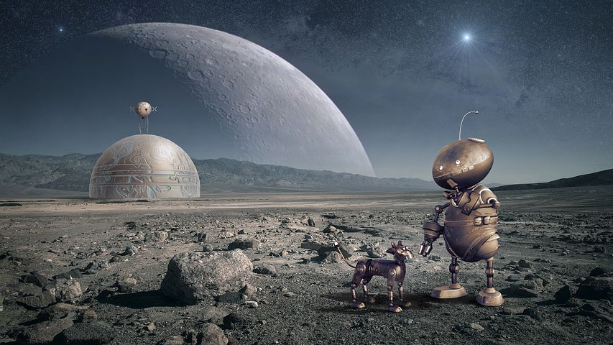
Today we thought about ships in the past.
What might ships look like in the future?

