Slide 1
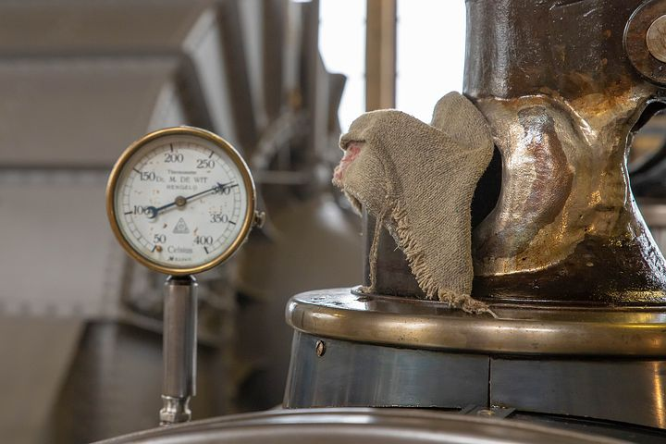
LO: To carry out an investigation to answer a scientific question
Success Criteria
I can plan my investigation.
I can set up my investigation.
I can conclude my investigation.

Slide 2
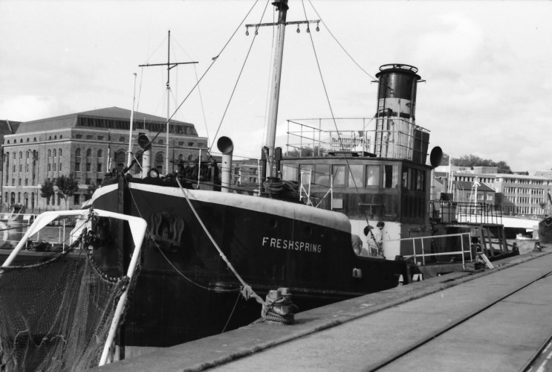
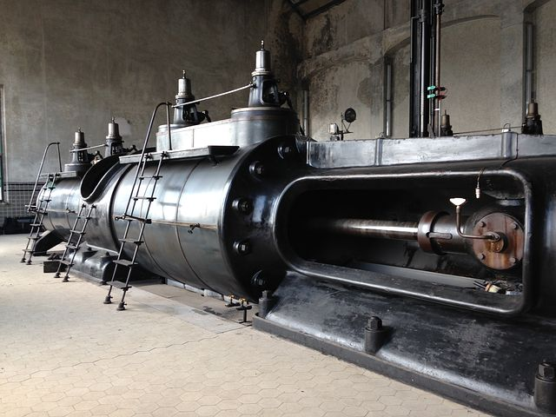
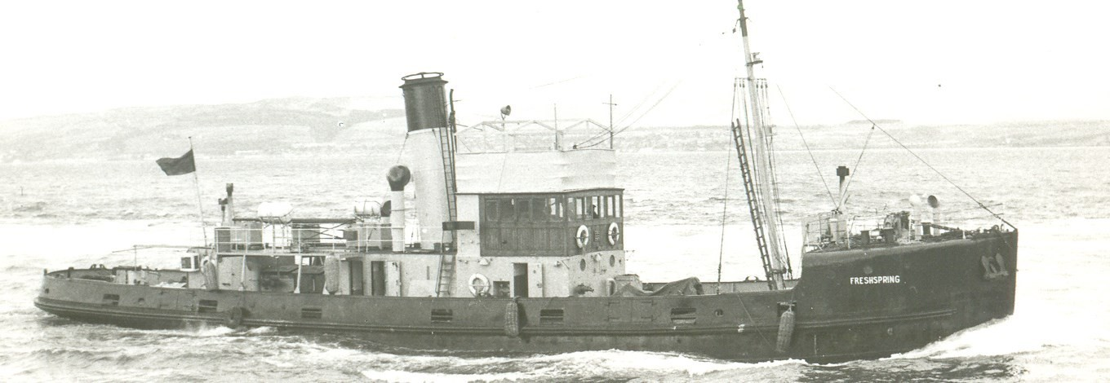
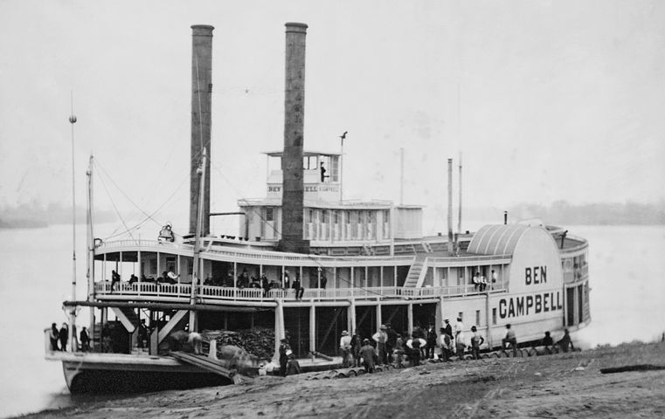
LO: To carry out an investigation to answer a scientific question
SS Freshspring is a steam ship.
What are steam ships? How do they work?

Slide 3
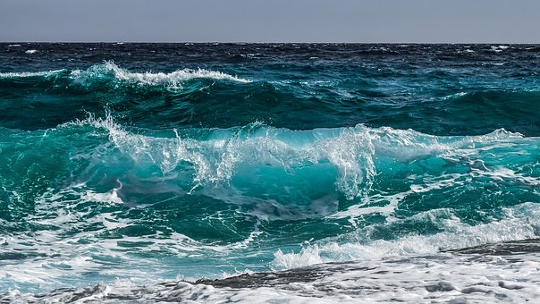
LO: To carry out an investigation to answer a scientific question
Where would be a logical place for steam ships to get their water from?
Actually, steam ships normally carry fresh water on board to use in their boilers, rather than get it from the sea.
Why do you think this is?

Slide 4
LO: To carry out an investigation to answer a scientific question
Investigation question:
Why do steam ships carry fresh water?

Slide 5
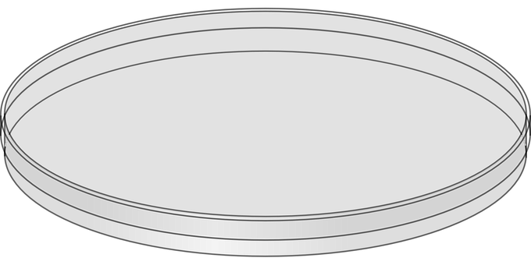
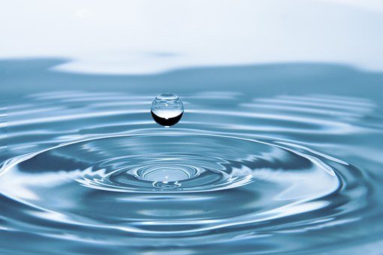
LO: To carry out an investigation to answer a scientific question
Investigation question:
Why do steam ships carry fresh water?
Here is the equipment we will be using in our investigation….
How do you think we will set up our investigation?

Slide 6
LO: To carry out an investigation to answer a scientific question
Investigation question:
Why do steam ships carry fresh water?
Method:
Variables:
The variables that will stay the same are…
The independent variable is…

Slide 7
LO: To carry out an investigation to answer a scientific question
Investigation question:
Why do steam ships carry fresh water?
Prediction:
I predict that…
I think this because…

Slide 8
LO: To carry out an investigation to answer a scientific question
Investigation question:
Why do steam ships carry fresh water?
Let’s set up our investigation!
How will you make sure your investigation is fair?

Slide 9
LO: To carry out an investigation to answer a scientific question
Investigation question:
Why do steam ships carry fresh water?
Conclusion:
I observed that…
I think this happened because…
If salty sea water were to be used in a boiler on a steam ship, the boiler would soon fill up with salt and not work anymore. This is why fresh water is more commonly used!

