Slide 1
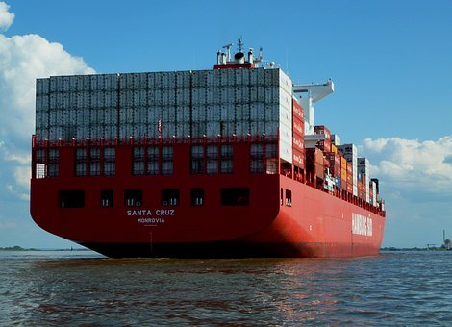
LO: To carry out an investigation to answer a scientific question
Success Criteria
I can plan my investigation.
I can consider the variables in my investigation.
I can record my observations
I can conclude my investigation.

Slide 2
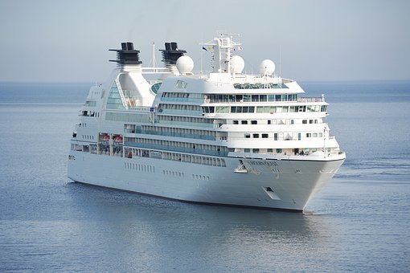
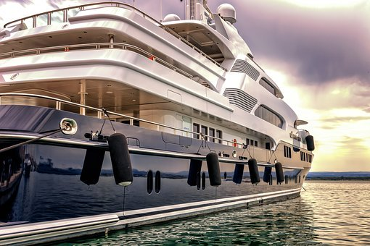
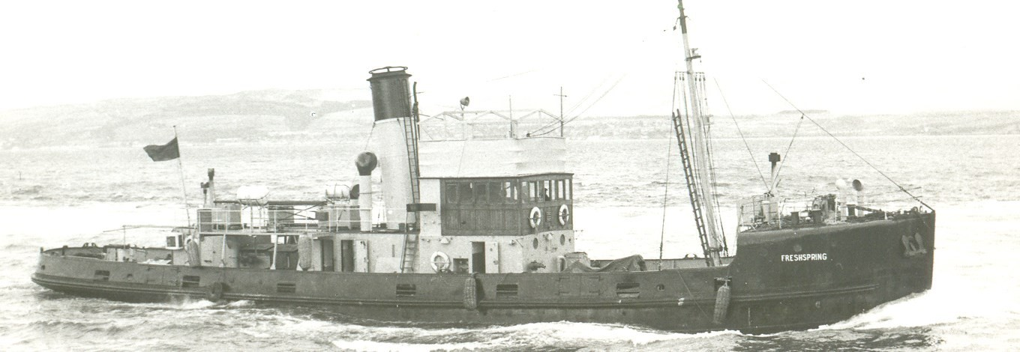
LO: To carry out an investigation to answer a scientific question
What materials are ships made from?
How heavy do you think ships are?
Ships can weigh more than 100,000 tons!

Slide 3
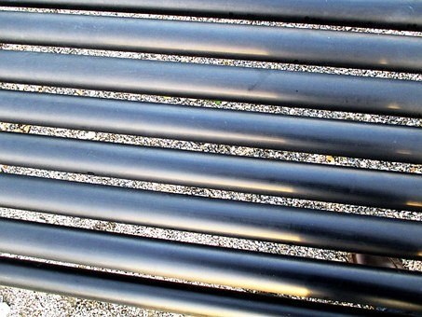
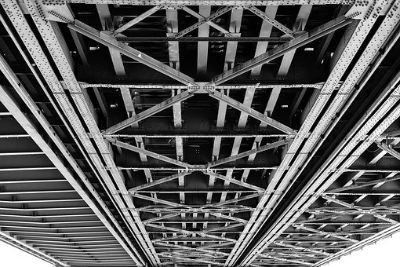
LO: To carry out an investigation to answer a scientific question
Lots of ships are made from steel.
What is steel? How heavy is steel?
If steel is a fairly heavy material and ships are often filled with heavy things too, why don’t ships sink?

Slide 4
LO: To carry out an investigation to answer a scientific question
Investigation question:
How do ships float?

Slide 5
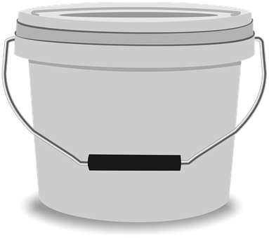
LO: To carry out an investigation to answer a scientific question
Investigation question:
How do ships float?
Here is the equipment we will be using in our investigation….
How do you think we will set up our investigation?

Slide 6
LO: To carry out an investigation to answer a scientific question
Investigation question:
How do ships float?
Method:
Variables:
The variables that will stay the same are…
The independent variable is…

Slide 7
LO: To carry out an investigation to answer a scientific question
Investigation question:
How do ships float?
Prediction:
I predict that…
I think this because…

Slide 8
LO: To carry out an investigation to answer a scientific question
Investigation question:
How do ships float?
Let’s set up our investigation!
How will you make sure your investigation is fair?

Slide 9
LO: To carry out an investigation to answer a scientific question
Investigation question:
How do ships float?
Conclusion:
I observed that…
I think this happened because…

